Slide 1

A Project report on ENERGY TRANSITION IN NIGERIA'S DOWNSTREAM OIL AND GAS SECTOR:
BY
STEPHANIE OSAS EHIZOKHALE
20230011
School Of Post Graduate Studies.
Petroleum and Gas Engineering Department.
Supervisor: Professor Abdullahi Gimba
MARCH 2025.

Slide 2
PRESENTION OUTLINES
Introduction
Literature Review
Statement of Problem
Aim and Objectives
Methodology
Result and discussion of result
Conclusion and Recommendation
References

Slide 3
INTRODUCTION
Energy transition : A major structural change to energy supply and consumption in an energy system.
Nigeria's downstream oil and gas sector : integral of Nigeria’s economy, providing energy for domestic consumption and supporting industrial growth.
Global energy policies : Decarbonization, sustainability
Renewable energy : Solar and wind Energy

Slide 4
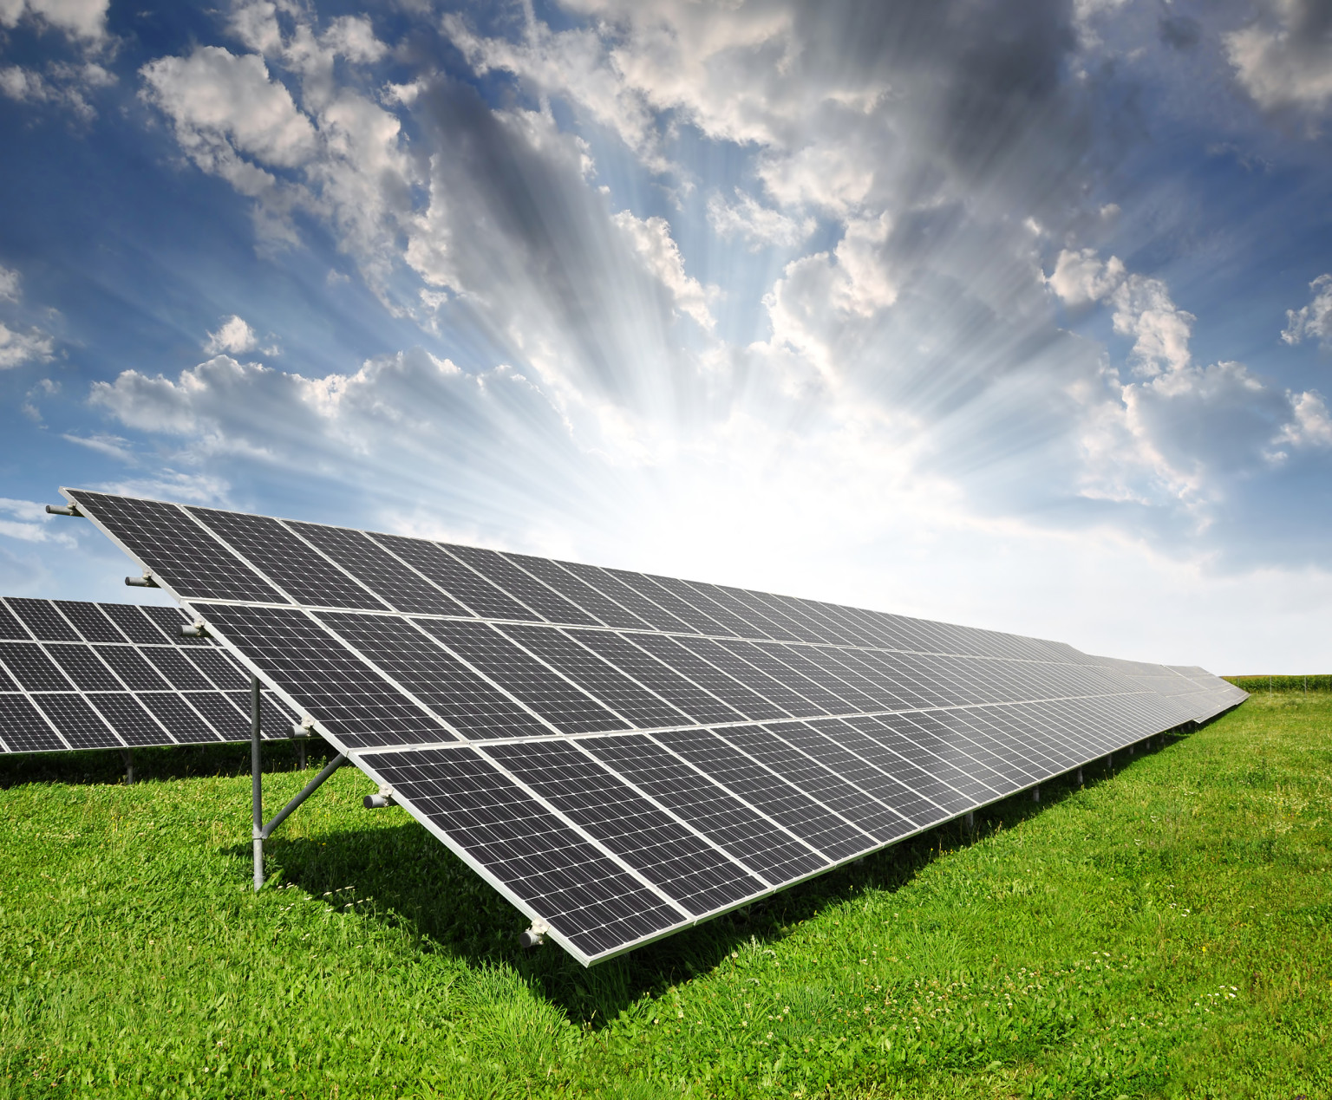

Slide 5
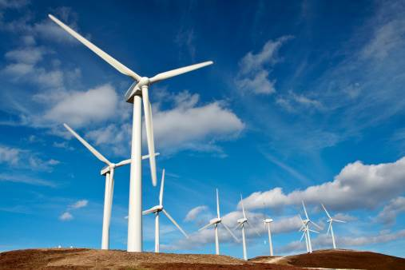

Slide 6
LITERATURE REVIEW
A review of existing literature reveals critical insights into the dynamics of energy transition, the role of the downstream oil and gas sector, and the integration of renewable energy in developing economies like Nigeria.
S/N | AUTHOR | TOPIC | AIM | OUTCOME GAP
1 | Sambo, 2009; | Renewable Energy Potential in Nigeria | To harness solar energy potentials in the northern region | Renewable energy adoption in the country remains limited due to financial, regulatory, and infrastructural barriers
2 | Jain & Sharma, 2019 | Global Perspectives and Lessons for Nigeria | To address the identified research gaps by exploring practical strategies adopted by nations for renewable energy integration, | Transition is uneven, with significant disparities between developed and developing economies due to infrastructural, financial, and policy constraints
3 | Adewuyi & Awopone, 2021). | The Concept of Energy Transition | To address the unique challenges in aligning with global energy transition trends | It underscores the critical need for integrating renewable energy into Nigeria’s downstream oil and gas sector as part of the broader energy transition

Slide 7
STATEMENT OF PROBLEM
Nigeria's downstream oil sector plagued by systemic challenges.
weak regulatory frameworks : Hinderance to renewable energy
Incorporation of renewable energy sources effectively
Lack technological, financial, and policy interventions

Slide 8
AIM AND OBJECTIVES
Aim
The aim of this research is to explore strategies for integrating renewable energy sources into refining and distribution
Objectives
To Explore how renewable energy can be integrated into the downstream sector to reduce the dependency on fossil fuels, lower operational costs, and support sustainability goals.
To Evaluate the feasibility of hybrid renewable energy solutions for refineries and distribution centres in Nigeria
To Assess the potential socioeconomic benefits and challenges of transitioning to renewable energy in the downstream sector, including job creation, energy security, and economic diversification.
To Develop actionable recommendations for stakeholders, including policymakers, industry players, and investors, to accelerate the energy transition in Nigeria’s downstream oil and gas sector.

Slide 9
METHODOLOGY
Research Design
Data Collection Methods
Data Analysis Techniques
Framework Development
Limitations

Slide 10
EXPECTED OUTCOMES
Roadmap for transforming Nigeria’s downstream oil and gas sector into a more sustainable, efficient, and globally competitive industry
Actionable policy
Social economic benefit of the energy transition.
The need for Energy Mix system in Nigeria

Slide 11
REFERNCES
Adewuyi, A. O., & Awopone, M. S. (2021). "Challenges and prospects of renewable energy in Nigeria: A review." Renewable and Sustainable Energy Reviews, 143, 110866.
Explores renewable energy potential in Nigeria and highlights barriers to integration.
Aigbedion, I. N., & Iyayi, S. E. (2007). "Environmental effects of mineral exploitation in Nigeria." International Journal of Physical Sciences, 2(2), 033-038.
Discusses environmental impacts of oil and gas activities in Nigeria.
Anifowose, B., Lawler, D. M., van der Horst, D., & Chapman, L. (2012). "Evaluating interdiction of oil pipelines and facilities as a counterinsurgency strategy in Nigeria." Energy Policy, 44, 347-356.
Examines issues in Nigeria's downstream sector, including vandalism and distribution challenges.
Ohunakin, O. S., Adaramola, M. S., Oyewola, O. M., & Fagbenle, R. O. (2014). "Solar energy applications and development in Nigeria: Drivers and barriers." Renewable and Sustainable Energy Reviews, 32, 294-301.
Reviews solar energy potential in Nigeria and discusses opportunities for its application.

Slide 12
RR REFERNCES
International Energy Agency (IEA). (2022). Africa Energy Outlook 2022.
Provides insights into Africa’s energy transition and renewable energy trends.
Nigerian National Petroleum Corporation (NNPC). (2020). Annual Statistical Bulletin.
Offers detailed statistics on Nigeria’s oil and gas sector, including downstream operations.
Federal Ministry of Power. (2015). National Renewable Energy and Energy Efficiency Policy (NREEEP).
Outlines Nigeria’s policy framework for renewable energy adoption and energy efficiency.
Abubakar, I. R., & Olanrewaju, B. T. (2019). "Renewable energy deployment in Nigeria: Barriers and policy recommendations." Energy Policy, 128, 426-436.
Focuses on policy recommendations for renewable energy in Nigeria’s energy sector.

Slide 13
THANK YOU

